Slide 1
Metabolic Bone Disease
S Jayamanne

Slide 2
Outline
Normal bone structure
Normal calcium/phosphate metabolism
Presentation and investigation of bone metabolism disorders
Common disorders of bone metabolism

Slide 3
Normal Bone Structure
What are the normal types of bone in the mature skeleton?
Lamellar
  Cortical
  Cancellous
Woven
  Immature
  Healing
  Pathological

Slide 4
What is the composition of bone?
The matrix
  40% organic
    Type 1 collagen (tensile strength)
    Proteoglycans (compressive strength)
    Osteocalcin/Osteonectin
    Growth factors/Cytokines/Osteoid
  60% inorganic
    Calcium hydroxyapatite
The cells
  osteo-clast/blast/cyte/progenitor

Slide 5
Calcium metabolism
What is the recommended daily intake?
1000mg
What is the plasma concentration?
2.2-2.6mmol/L
How is calcium excreted?
Kidneys - 2.5-10mmol/24 hrs
How are calcium levels regulated?
PTH and vitamin D (+others)

Slide 6
Phosphate metabolism
Normal plasma concentration?
0.9-1.3 mmol/L
Absorption and excretion?
Gut and kidneys
Regulation
Not as closely regulated as calcium but PTH most important

Slide 7
PTH
Physiological role
Production related to plasma calcium levels
Control of calcium levels
  target organs
    bone - increased Ca/PO4 release
    kidneys
      increased reabsorption of Ca
      increased excretion of PO4
    gut - indirect increase in calcium reabs by stimulting activation of vitamin D metabolism

Slide 8
Calcitonin
Physiological role
Levels increased when serum Ca >2.25mmol/L
Target organs
  Bone - suppresses resorption
  Kidney - increases excretion

Slide 9
Vitamin D (cholecalciferol)
Sources of vit D
Diet
u.v. light on precursors in skin
Normal daily requirement
400IU/day
Target organs
  bone - increased Ca release
  gut - increased Ca absorption

Slide 10
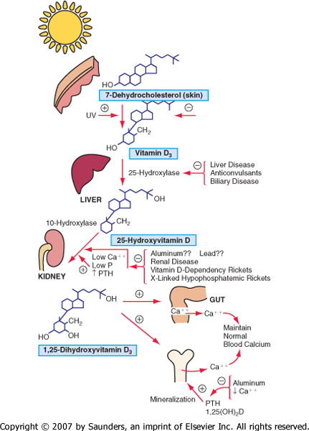
Vitamin D metabolism

Slide 11
Normal metabolism
Vit D
25-HCC (Liver)
1,25-DHCC 24,25-DHCC
(Kidney) (Kidney)

Slide 12
Factors affecting bone turnover
Other hormones
Oestrogen
  gut - increased absorption
  bone - decreased re-absorption
Glucocorticoids
  gut - decrease absorption
  bone - increased re-absorption/decreased formation
Thyroxine
  stimulates formation/resorption
  net resorption

Slide 13
Factors affecting bone turnover
Other factors
Local stresses
Electrical stimuln
Environmental
  temp
  oxygen levels
  acid/base balance

Slide 14
Bone metabolic disorders
Skeletal abnormality
  osteopenia –Rickets osteomalacia/osteoporosis
  osteitis fibrosa cystica - replacement of bone with fibrous tissue usually due to PTH excess
Hypercalcaemia
Underlying hormonal disorder
When to investigate?
  Under 50
  repeated fractures or deformity
  systemic features or signs of hormonal disorder

Slide 15
Bone metabolic disorders
Assessment
History
  duration of sx
  drug rx
  causal associations
Examn
X-rays - plain and specialist (cort index/Singh index/DEXA)
Biochemical tests
Bone biopsy

Slide 16
Biochemical tests
Which investigations?
Ca/PO4 - plasma/excretion
Alkaline phosphatase/(o’blast activity)
PTH
vit D uptake
hydroxyproline excretion

Slide 17
Hypocalcemic disorders
Hypoparathyroidism
Pseudohypoparathyroidism.
Hypomagnesemia.
Vitamin D abnormalitie
Diatary
Renal.
Hepatic

Slide 18
Hypophosphatemic disorders of childhood
Primary hypophosphatemic rickets.
.
Complex proximal tubulopathy ( Fanconi syndrome).

Slide 19
Rickets and Osteomalacia

Slide 20
Rickets & osteomalacia usually occur together as long as the growth plates are open; only osteomalacia occurs after the growth plates have fused.

Slide 21
Etiology
Deficient Intake: Ca, Ph, Vit D.
Poor absorption: vit fat malabsorption
Increased excretion:, renal tubular dysfunction phosphaturia, RTA with hypercalciuria
Local effect on bone matrix: hypophosphatasia

Slide 22
Causes of Rickets
VITAMIN D DISORDERS Nutritional vitamin D deficiency; CRF
CALCIUM DEFICIENCY
PHOSPHORUS DEFICIENCY
RENAL LOSSES X-linked hypophosphatemic rickets; Autosomal dominant hypophosphatemic rickets; Hereditary hypophosphatemic rickets with hypercalciuria; Overproduction of phosphatonin ( Tumor-induced rickets, McCune-Albright syndrome’ Epidermal nevus syndrome, Neurofibromatosis) ,Fanconi syndrome, Dent disease
DISTAL RENAL TUBULAR ACIDOSIS

Slide 23
Rickets, clinical manifestations
Skeletal findings:
Delay in closure of the fontanelles.
Parietal & frontal bossing.
Craniotabes ( soft skull bones).
Enlargement of the costochondral junction (rachitic rosary).
The development of Harrison sulcus ( caused by pull of the diaphragmatic attachments to the lower ribs).
Enlargement of the wrist & bowing of the distal radius & ulna.
Progressive lateral bowing of the femur & tibia.

Slide 24
Extra skeletal findings
.
Hypoplasia of the dental enamel is typical for hypocalcemic rickets,
Abscesses of the teeth occur more often in phosphopenic rickets.
Hypocalcemic seizures,
Decreased muscle tone leading to delayed motor milestones,
Recurrent infections, increased sweating.

Slide 25
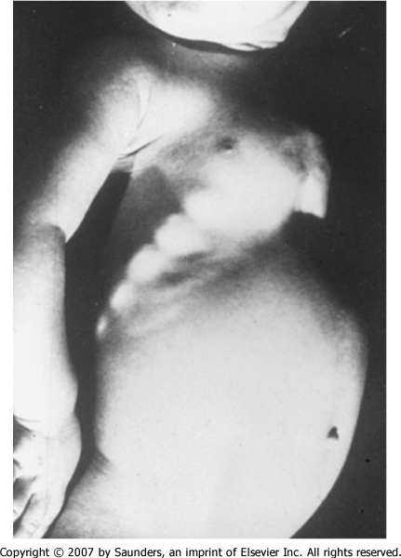

Slide 26
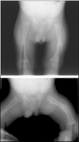
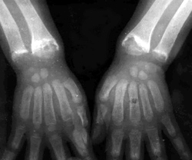
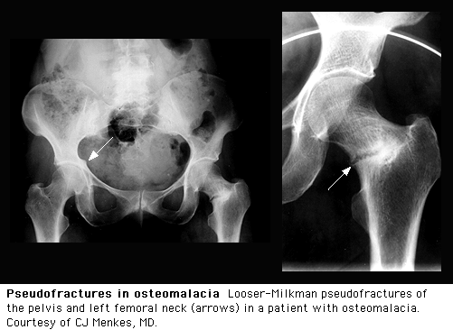
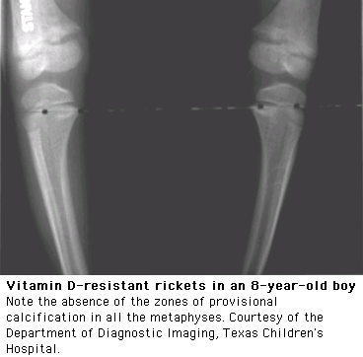

Slide 27
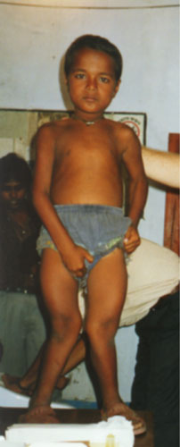
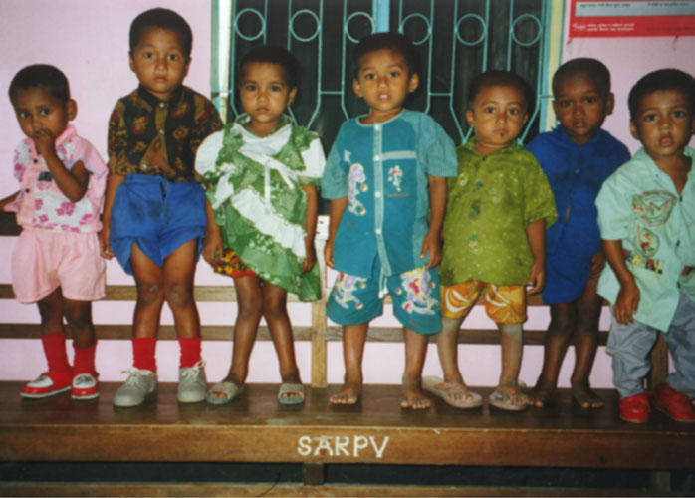

Slide 28
Biochemical findings in rickets
Alkaline phosphatase usually is ↑in all forms of rickets.
Serum phosphorus concentrations usually are↓ in both hypocalcemic and hypophosphatemic rickets.
Serum Ca is ↓only in hypocalcemic rickets.
Serum parathyroid hormone typically is ↑in hypocalcemic rickets, in contrast it is N in hypophosphatemic rickets.

Slide 29
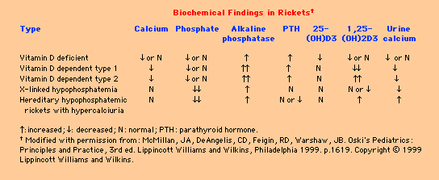

Slide 30
Treatment of Rickets
Vitamin D. stoss therapy: 300,000-600,000 iu orally or IM in 2-4 divided doses over one day.
High dose vit D 2000-5000 iu orally for 4-6wks followed by 400iu daily orally as maintenance.
Adequate dietary Calcium & phosphorus provided by milk, formula & other dairy products.
Symptomatic hypocalcaemia need IV cacl as 20mg/kg or ca gluconate as 100mg/kg as a bolus, followed by oral calcium tapered over 2-6 weeks.

Slide 31
Osteomalacia
Types
Vitamin D deficient
Hypophosphataemic
  growth decr +++ and severe deformity with wide epiphyses
  x-linked dominant
  decreased tubular reabs of PO4
  Ca normal but low PO4
  Rx PO4 and vit D

Slide 32
Osteomalacia vs osteoporosis
Osteomal Osteopor
Ill Not ill
General ache Asympt till #
Weak muscles normal
Loosers weight nil
Alk phos incr normal
PO4 decr normal
Ca x PO4 <2.4 Ca x PO4 >2.4

Slide 33
Hyperparathyroidism
Excessive PTH
Due to prim (adenoma), sec (hypocalc), tert (second hyperact -> autonomous overact)
Osteitis due to fibr repl of bone
Clin feat - hypercalc
Invest - Calc incr, PO4 decr, incr PTH
Rx surg

Slide 34
Renal osteodystrophy
Combination of
osteomalacia
secondary PTH incr
osteoporosis/sclerosis
CF - renal disorder, depends on predom pathology
Rx - vit D or 1,25-DHCC
renal disorder correction

Slide 35
Pagets
Bone enlargement and thickening
Incr o-clast/blast activity -> increased tunrover
Aet - unknown but racial diff ?viral
CF - M=F, >50, ache but not severe unless fracture or tumour
Inv - x-ray appearance characteristic, alk ph is increased and increased hydroxyproline in urine
Rx - bisphos, calcitonin

Slide 36
Endocrine disorders
Cushings
Hypopituitarism - GH def - prop dwarf or Frohlich adiposogenital syndrome
Hyperpituitarism - gigantism or acromegaly
Hypothyroidism - cretinism or myxoedema
Hyperthyroidism - o’porosis
Pregnancy - backache, CTS, rheumatoid improves SLE gets worse

Slide 37
Osteoporosis

Slide 38
Definition
A progressive systemic skeletal disease characterised by low bone mass and micro-architectural deterioration of bone tissue, with a consequent increase in bone fragility and susceptibility to fracture

Slide 39
Risk factor
menopausal
age > 55
Low calcium intake
immobilization
heavy drinking
Drugs : - thyroid hormone, steroid
RA , Cushing’s syndrome , hyperthyroidism, hypogonadism

Slide 40
Clinical
No symptom
Fracture : fractures of the hip, spine, and wrist are the most common, fractures of any skeletal site (such as pelvis, humerus, tibia, femur, elbow, and ribs) can occur
Bone pain

Slide 41
Complication
risk of fracture increases as bone density decreases
Advance age
  An increased risk of falling
traumatic fractures(motor vehicle accidents) : more common in people with lower bone mass

Slide 42
Diagnosis
Bone Mass Measurement
the gold standard is dual-energy x-ray absorptiometry (DXA) : measurement of any skeletal site (the complete skeleton)
  z score : possibility of secondary causes of bone loss (below -2.0)
  t score : osteoporosis diagnosis
        normal ; above -1
        osteopenia ; -1 to -2.5
        osteoporosis ; < -2.5

Slide 43
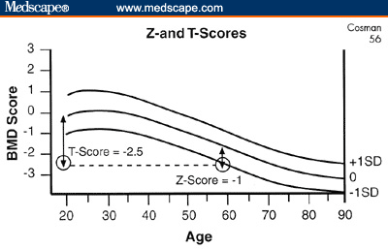

Slide 44
Indication
all women by the age of 65
younger women at the time of menopause if they have risk factors for osteoporosis
on long-term glucocorticoids, glucocorticoid therapy > 3 months
All patients have diseases or on medications known to lead to osteoporosis
no specific recommend in health men(may be routine in age 70-75)

Slide 45
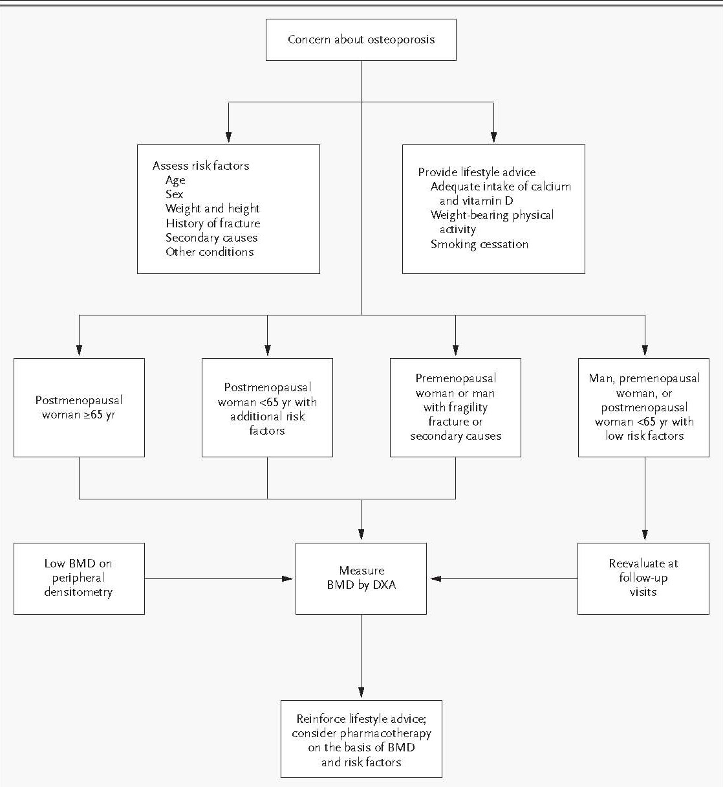

Slide 46
Diagnosis(2)
Other
Biochemical markers of bone turnover
  bone formation (bone-specific alkaline phosphatase)
  bone resorption (serum or urine N-telopeptide)

Slide 47
Prevention and Treatment
Fracture management
Prevention
  Reduce risk factors
  Nutrition (calcium and vit D )
  Exercise (weight-bearing exercise)

Slide 48
Medical treatment
I. Inhibitors of bone turnover
II. Stimulators of bone formation
III. Heterogenous effect

Slide 49
I. Inhibitors of bone turnover
Estrogens with and without progestogens
Estrogens derivatives and receptor agonists
  Tamoxifen, raloxifene
  Tibolone
Calcium
  Calcitonins
  Biphosphanates (Etidronate, Alendronate, Residronate, Pamidronates and others)

Slide 50
II. Stimulators of bone formation
Fluoride
  Sodium fluoride
  Monofluorophosphate
Parathyroid hormone and other peptides
Vit K₂ devivative-menatetrenone

Slide 51
III. Heterogenous effect
Anabolic steroid
Vitamin D and derivatives
  Calciferol and cholecalciferol (vitamin D₂, D₃)
  Calcitriol
  Alfacalcidol

Slide 52
Confirm diagnosis of osteoporosis by DXA
Normal
Osteopenia
Osteoporosis
Lifestyle advice
Lifestyle advice
Reassure lifestyle advice
Calcium & Vit D
and
HRT / SERMs
Bisphosphonates
Calcium + vitamin D if current intake inadequate
One of the following
Bisphosphonates
HRT / SERMs
Calcitonin
or
Calcitriol

Slide 53
Estrogens/HRT
extremely effective in healthy postmenopausal women(menopausal symptoms) and in those with osteoporosis
reduce fractures of the hip and symptomatic fractures of the spine, both by 34%, and all other fractures by 24%
risk : cardiovascular disease, stroke, venous thromboembolism, and risk of breast cancer

Slide 54
Selective estrogen receptor modulators
Raloxifene:
  reduced the occurrence of vertebral fracture by 30% to 50%
  no significant effect on cardiovascular , stroke , breast cancer
  increase the occurrence of hot flashes , risk of venous thromboembolism

Slide 55
Calcitonin
Injected : Paget's disease, hypercalcemia, and osteoporosis in postmenopausal women who are more than 5 years from menopause
nasal spray : treatment of osteoporosis in late postmenopausal women

Slide 56
Bisphosphonates
reduced risk of vertebral and nonvertebral fractures
alendronate dose 10 mg/day 70 mg/weeks
residronate dose 5 mg/day
Problem -esophageal irritation

Slide 57
Teriparatide
recombinant human parathyroid hormone
All trials show that PTH is highly effective

Slide 58
Recommendations for the treatment of osteoporosis
Intervention Bone Mineral Vertebral fracture Hip fracture
Density decreased decreased
increased
Calcium(+ Vit D) A A B
Oestrogen A A B
Alendronate A A A
Risedronate A A A
Raloxifene A A B
Calcitonin A A B
Calcitriol A A # C

Slide 59
Monitoring
no currently accepted guidelines for monitoring osteoporosis treatment
bone mineral density : should not be repeated at intervals of less than 2 years.
a measure of bone resorption : initiating therapy and 3-6 months after starting therapy can provide an early estimate of patient response

